Slide 1
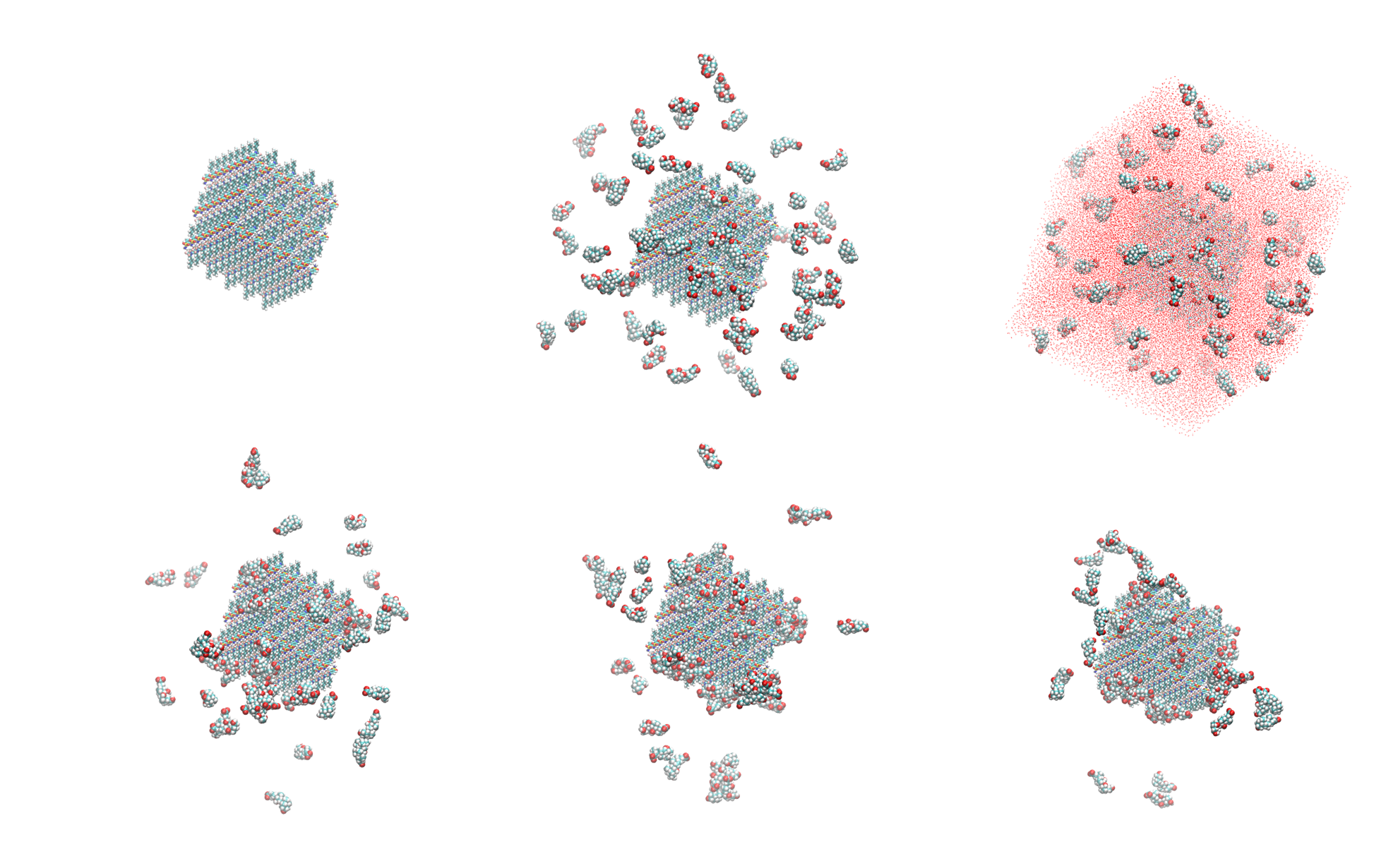
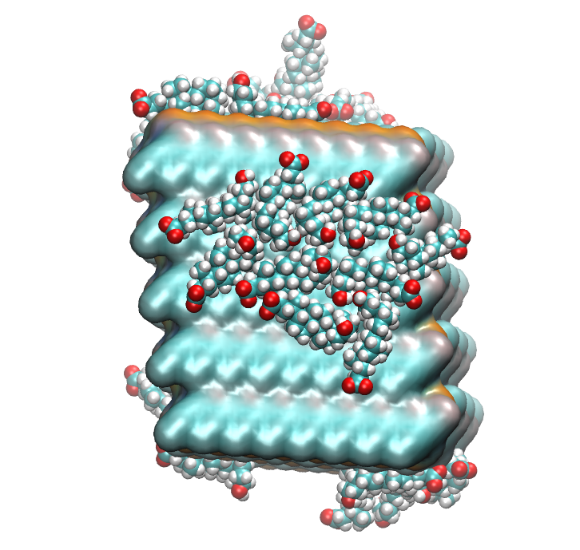
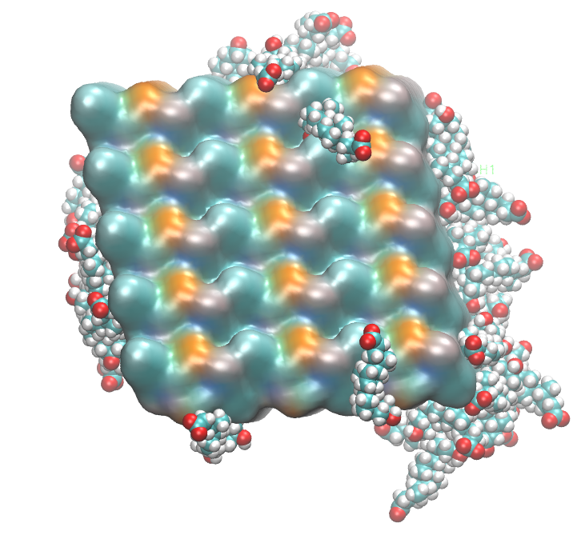
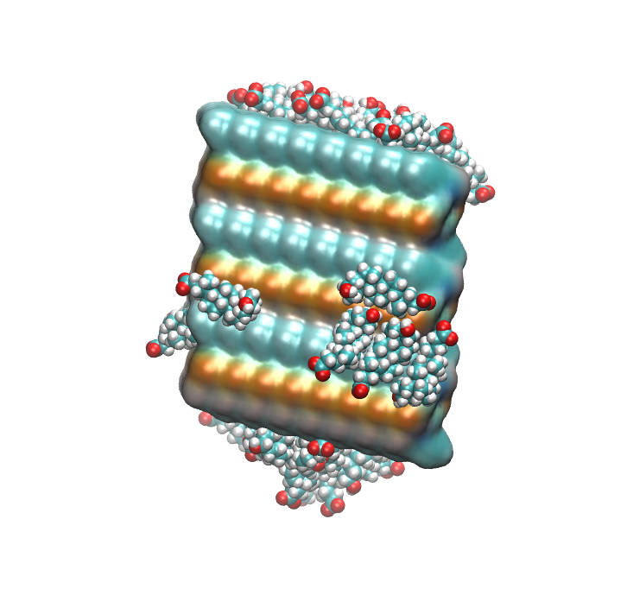
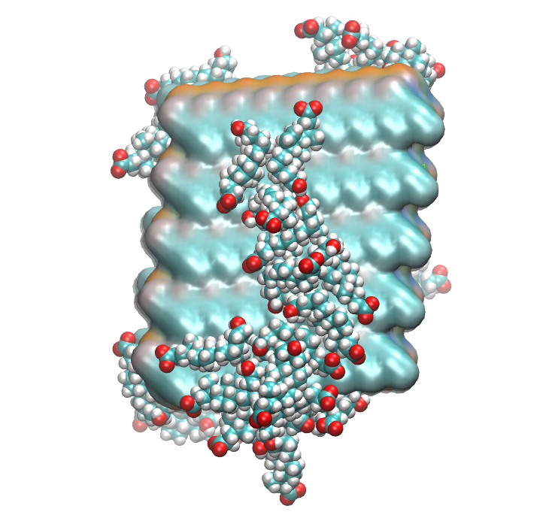
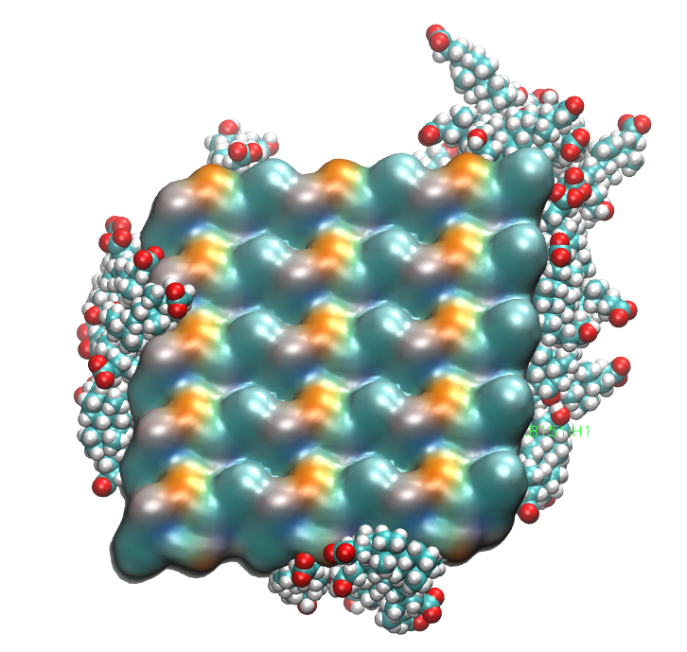
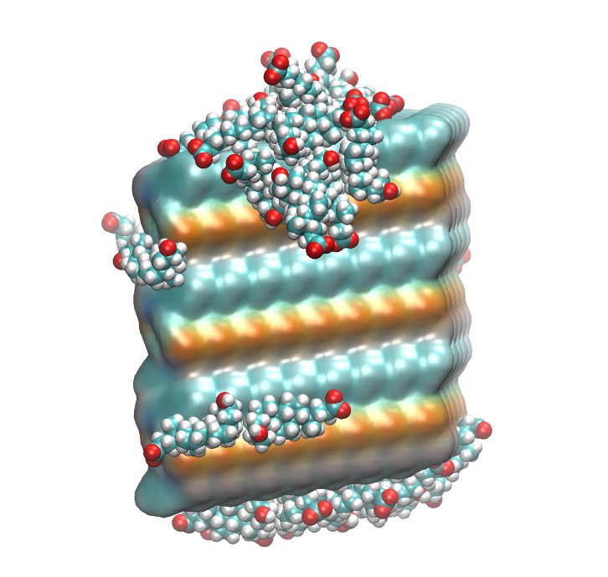
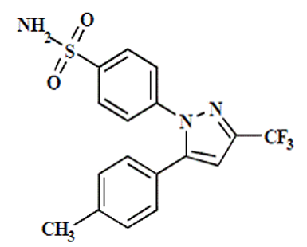
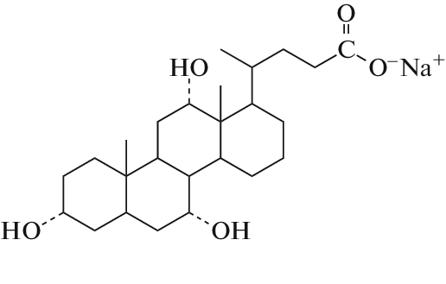
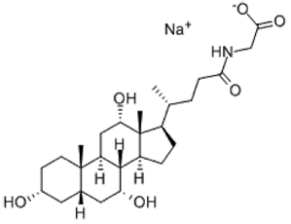
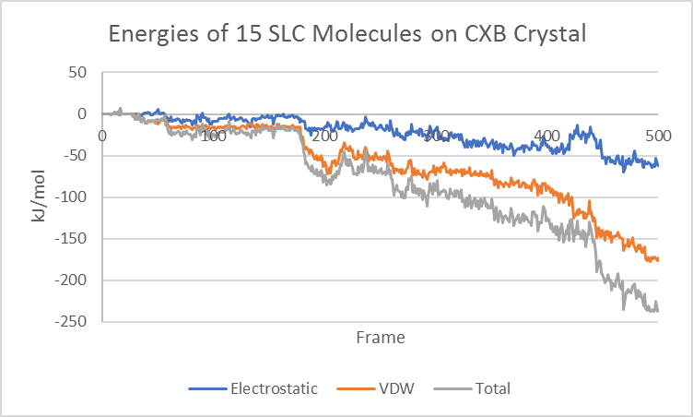
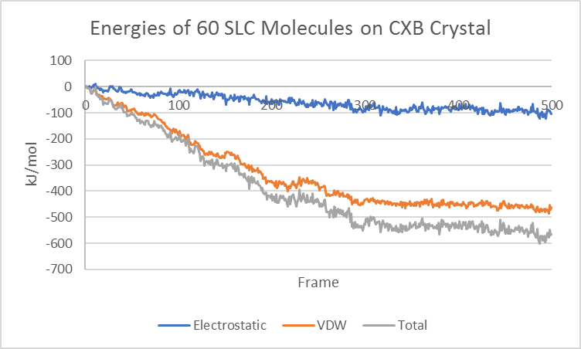
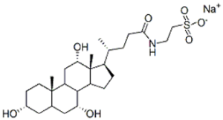
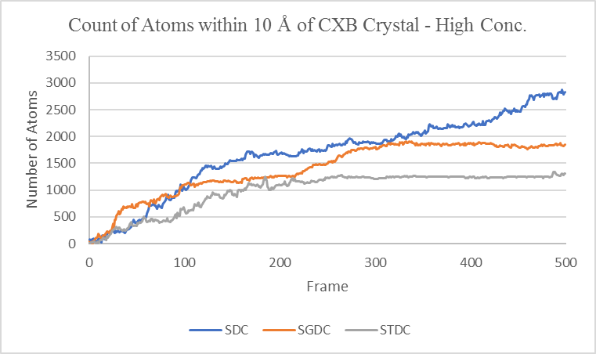
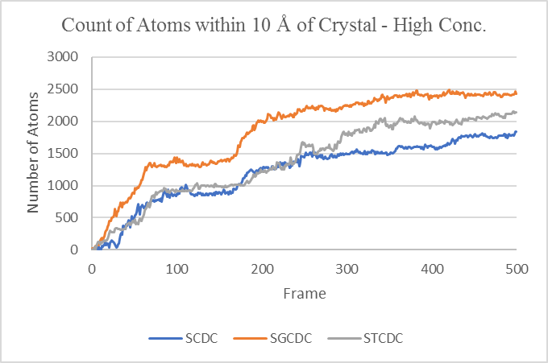
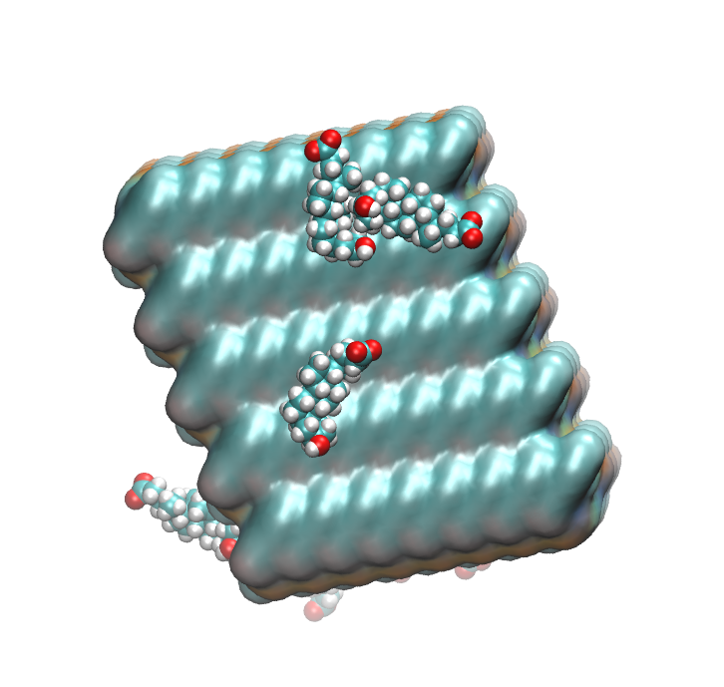
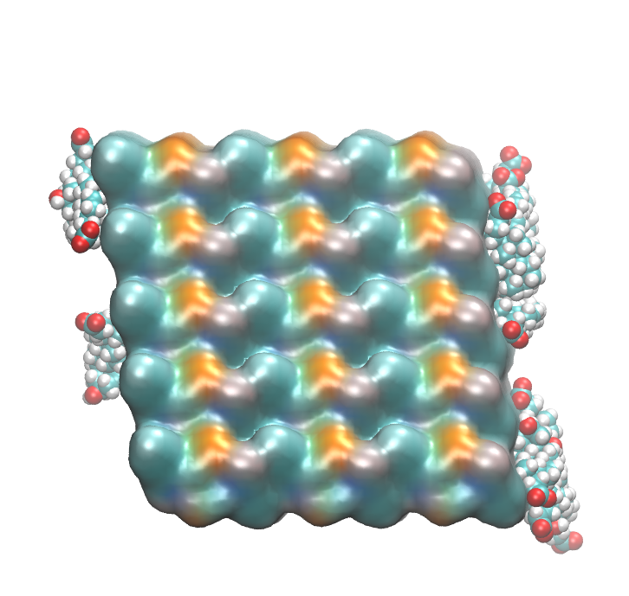
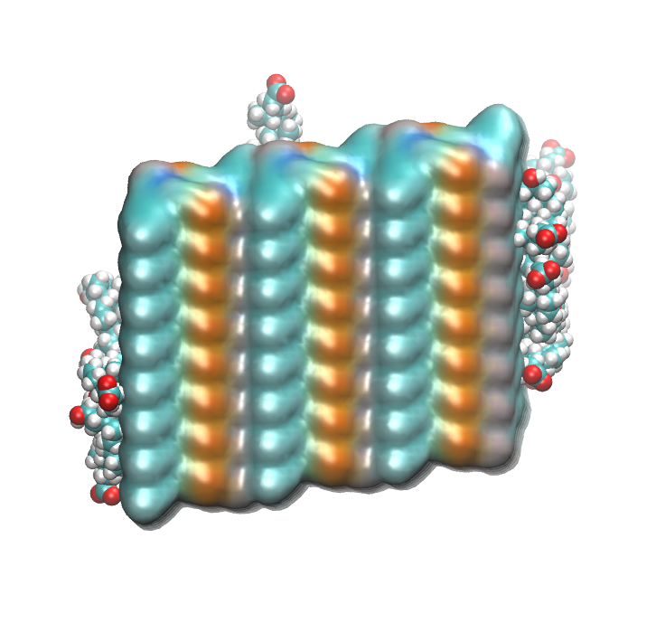
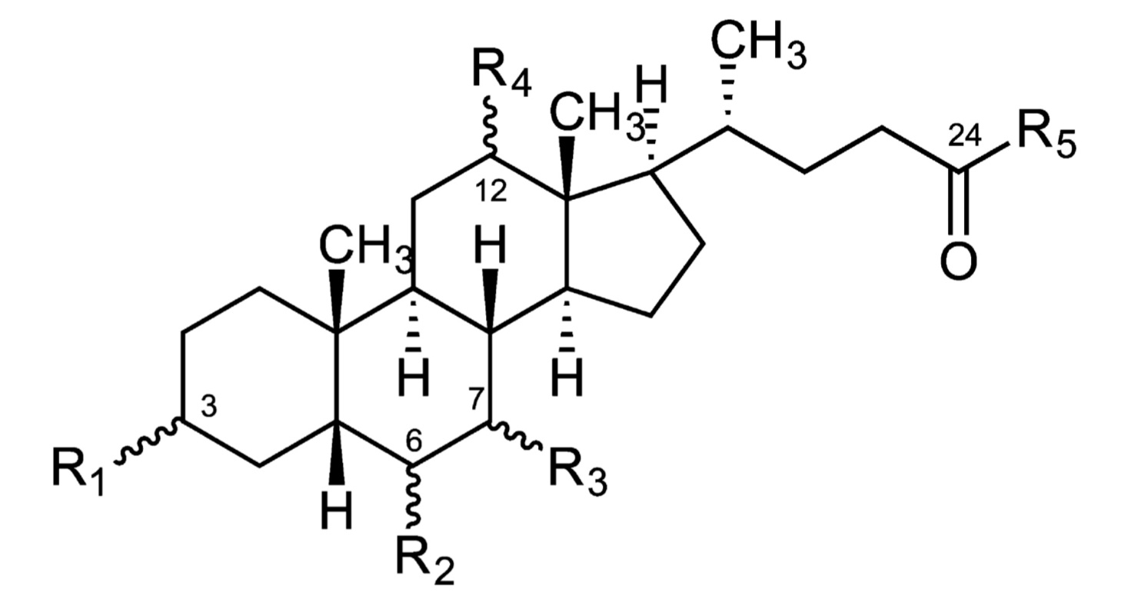
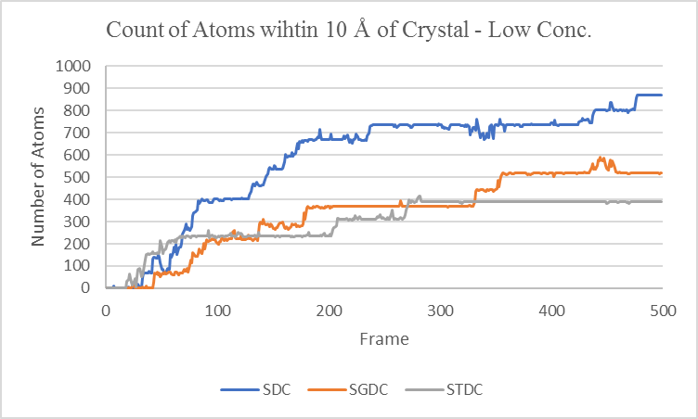
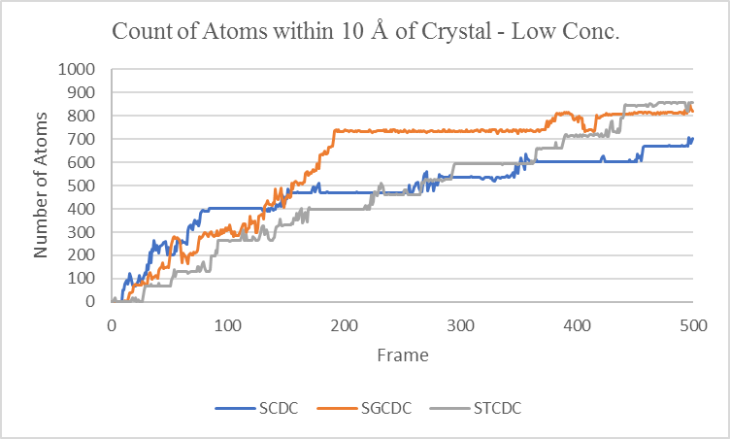
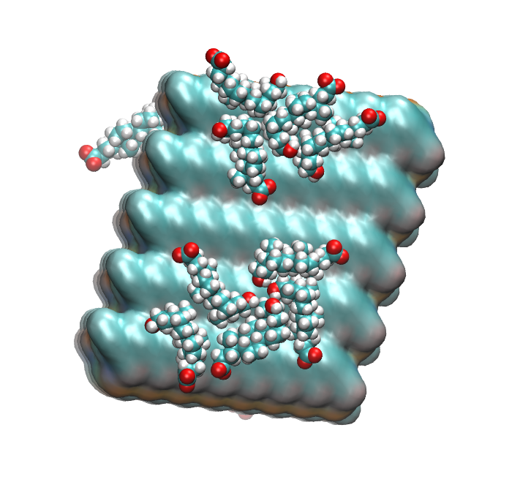
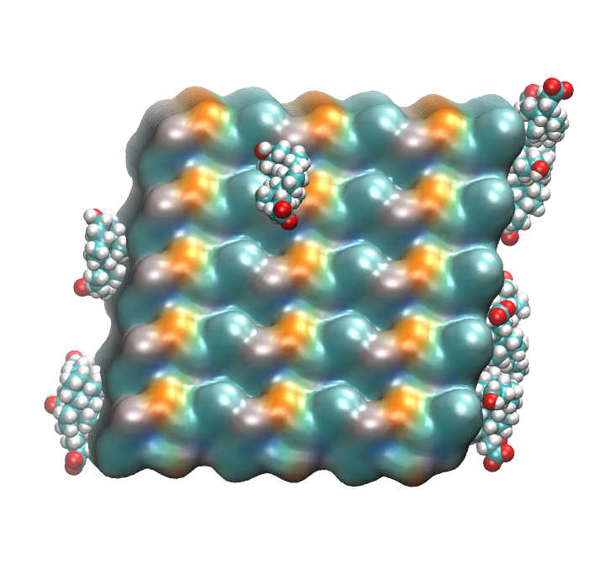
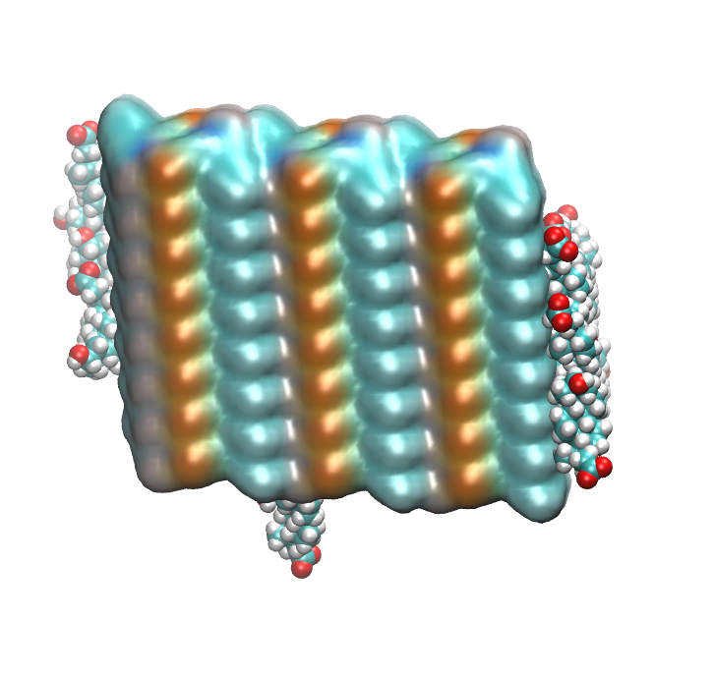
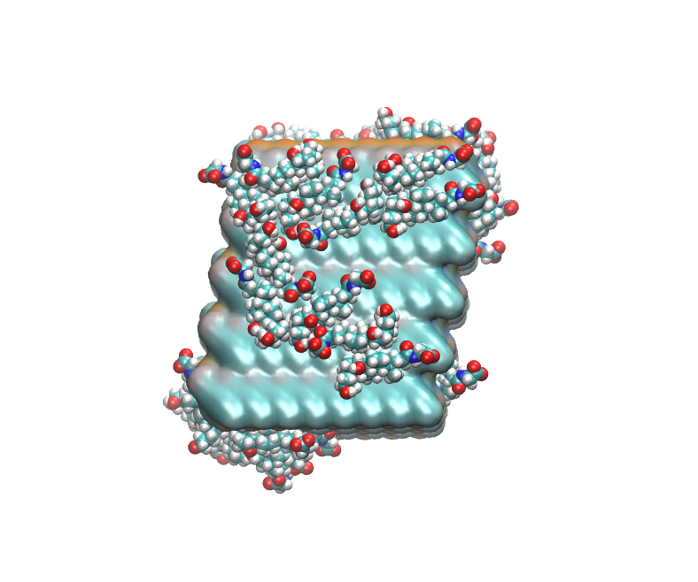
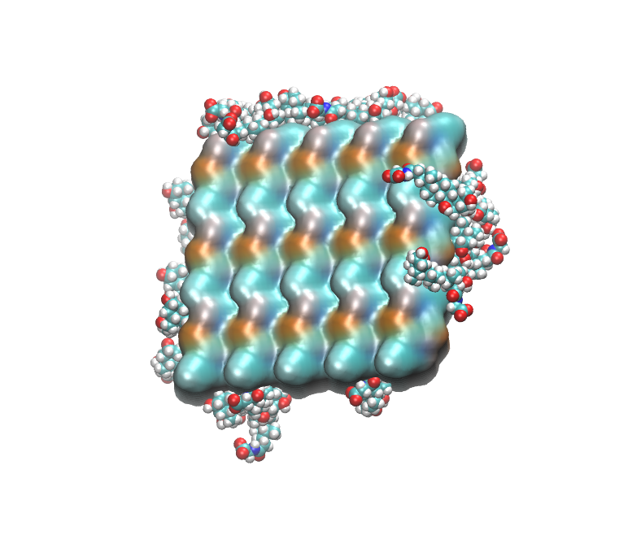
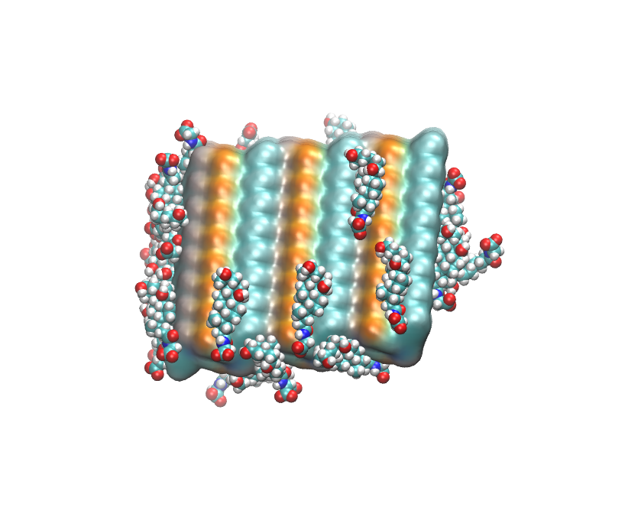
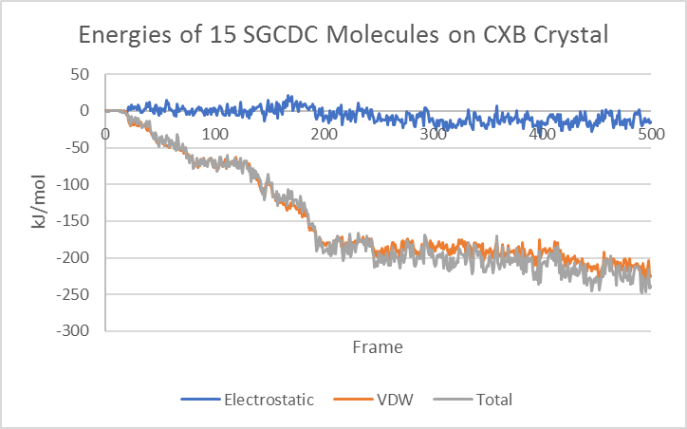
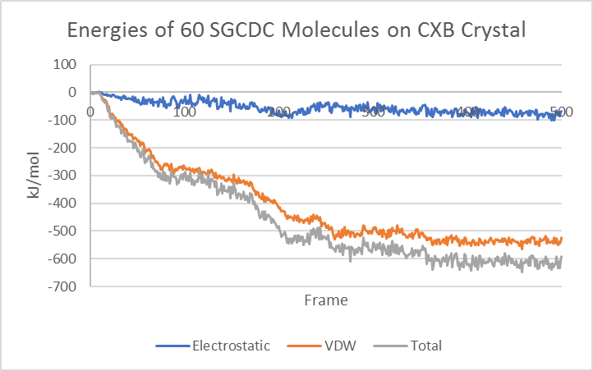
Simulations of Surfactant-Celecoxib Nanocrystal Interactions Caitlyn Smith, Maryana Gogol and Kenneth W. Olsen Department of Chemistry and Biochemistry, Loyola University Chicago 1068 west Sheridan Rd, Chicago, IL 60626
Abstract
Creating MD Simulations
Results
Using Molecular Dynamics (MD), the interactions of 13 bile salts with celecoxib nanocrystals were simulated. Celecoxib (Celebrex) is a NSAID commonly used in the treatment of osteoarthritis. A nanocrystal of celecoxib was placed at the center of a cube of water (120Ǻ of a side). The surfactants were placed randomly in this box at two different concentrations. The surfactants were 7 free, 4 glycine conjugated and 3 taurine conjugated bile salts. Using Nanoscale Molecular Dynamics, simulations were created for 100 ns, which were analyzed using Visual Molecular Dynamics. At the high surfactant concentration (60 surfactant molecules per water box) the kinetics of binding was biphasic, slowing after approximately 10 surfactants bound to the nanocrystal. At the low surfactant concentration (15 per box) the binding was slower and generally almost ceased when 10 molecules bound the nanocrystal.
a
b
c
a
b
c
d
e
f
d
e
f
Figure 3. (a) The CXB nanocrystal alone, fixed within the box. (b) The CXB nanocrystal with the surfactants, 60 SC molecules, placed randomly around the CXB. (c) The box filled with water and ions to simulate physiological conditions. Figures rendered from (d) frame 150, (e) frame 375 and (f) the end of the simulation, frame 499.
Figure 5. The final frames of the high concentration of SLC with the CXB. (a) (+x, 0, 0), (b) (0, +y, 0), (c) (0, 0, +z), (d) (-x, 0, 0), (e) (0, -y, 0), and (f) (0, 0, -z).
a
b
c
Results
a
b
Figure 1. (a) The molecular structure of celecoxib. The molecular structures of three of the 13 bile salts used in this assay: (b) sodium cholate (SC), (c) sodium glycocholate (SGC), and (d) sodium taurocholate (STC).
d
The patterns in the simulations were best observed at the high concentration, as the low concentration patterns equilibrated faster.
Importance
Graph 4. The interaction energies of the (a) low and (b) high interactions of SLC on the CXB nanocrystal, showing the electrostatic, VDW and total interactions.
Solubility is directly correlated to the bioavailability of drugs and has a coinciding effect on the drug dosages and efficacy. Molecular Dynamics (MD) is used to simulate and examine the patterns of interactions between the drug and surfactant. This assay focuses on a nanocrystal of celecoxib (CXB), in which simulations were created separately with 13 different bile salts at two concentrations.
a
b
a
b
c
Graph 1. (a) Graph 1a shows the amount of atoms of surfactant within 10 Å of the crystal comparing the simulations of 60 molecules of SDC, SGDC, and STDC. (b) Graph 1b shows the amounts of atoms of surfactant within 10 Å of the crystal, comparing the simulations of 60 molecules of SCDC, SGCDC and STCDC.
Figure 2. The base structure of the bile salt surfactants used. R-groups refer to Table 1.
Bile Salt, Sodium- | Abbrv. | R1 | R2 | R3 | R4 | R5
Cholate | SC | OH(α) | H | OH(α) | OH(α) | O⁻Na⁺
Deoxycholate | SDC | OH(α) | H | H | OH(α) | O⁻Na⁺
Chenodeocycholate | SCDC | OH(α) | H | OH(α) | H | O⁻Na⁺
Lithocholate | SLC | OH(α) | H | H | H | O⁻Na⁺
Ursodeoxycholate | SUDC | OH(α) | H | OH(β) | H | O⁻Na⁺
Hyodeoxycholate | SHDC | OH(α) | OH(α) | H | H | O⁻Na⁺
Glycocholate | SGC | OH(α) | H | OH(α) | OH(α) | NHCH₂COO⁻Na⁺
Glycodeoxycholate | SGDC | OH(α) | H | H | OH(α) | NHCH₂COO⁻Na⁺
Glycochenodeoxycholate | SGCDC | OH(α) | H | OH(α) | H | NHCH₂COO⁻Na⁺
Glycoursodeoxycholate | SGUDC | OH(α) | H | OH(β) | H | NHCH₂COO⁻Na⁺
Taurocholate | STC | OH(α) | H | OH(α) | OH(α) | NHCH2CH₂SO₃⁻Na⁺
Taurodeoxycholate | STDC | OH(α) | H | H | OH(α) | NHCH2CH₂SO₃⁻Na⁺
Taurochenodeoxycholate | STCDC | OH(α) | H | OH(α) | H | NHCH2CH₂SO₃⁻Na⁺
d
e
f
b
Figure 6. The final frame of the low concentration of SLC with the CXB crystal. (a) (+x, 0, 0), (b) (0, +y, 0), (c) (0, 0, +z), (d) (-x, 0, 0), (e) (0, -y, 0), and (f) (0, 0, -z).
Graph 2. (a) Graph 2a shows the amount of atoms of surfactant within 10 Å of the crystal comparing the simulations of 15 molecules of SDC, SGDC, and STDC. (b) Graph 2b shows the amounts of atoms of surfactant within 10 Å of the crystal, comparing the simulations of 15 molecules of SCDC, SGCDC and STCDC.
Discussion
The conjugation of the bile salt to more polar decreased the overall interactions. The different R-groups caused the pattern of interactions to change. The biphasic nature was seen amongst other bile salts than the chenodeoxycholates, which could be further analyzed to narrow the possible causes of the pattern. The interactions are shown to be more hydrophobic, relying on most Van der Waals forces. These forces cause the bile salts to interact with the more hydrophobic areas of the crystal, including ridges and the edges. SLC is the most hydrophobic of the surfactants and it binds almost exclusively to the most hydrophobic face of the CXB crystal, particularly at the lower surfactant concentration (Figure 6). In part this selectivity may be due to less electrostatic attraction for SLC (Graph 4) than for SGCDC (Graph 3).
a
b
c
Table 1. Table 1 lists all the bile salts used in this assay and describes the 5 R-groups on each. Figure 3 displays the location of the R-groups. Figure 1a shows the structure of SC, figure 1b shows the structure of SGC and Figure 1c shows the structure of STC.
Creating MD Simulations
Figure 4. Using the QuickSurf view for the crystal in VMD, the figures rendered are the final frame of the simulations of the high concentration of SGCDC with the crystal. The sides shown are (a) (-x,0,0), (b) (0,+y,0) and (c) (0,0,+z).
The structures of CXB and most of the bile salt surfactants were obtained from Cambridge Structural Database (CCDC) (Cambridge, UK). The few surfactants without structures were built from a similar bile salt using ChemSketch (ACD/Labs 2018.1.1, July 2018). Topography and parameter files for every molecule used were created using CGenFF (cgenff.parameters.org). Mercury Software (Mercury 2.3, CCDC 2001-2009) was used to build the nanocrystal of celecoxib. Using programs called PackMol (PackMol 18.169, June 2018), VMD (VMD, version 1.9.3, November 2016) and NAMD (NAMD, version 2.13, November 2018), conditions were set, 100 ns were simulated with 5 frames of data and analyzed.
a
b
References
Li, Na, Laura I Mosquera-Giraldo, Carlos H Borca, James D. Ormes, Michael B Lowinger, John Higgins, Lyudmila V. Slipchenko and Lynne S Taylor. “A Comparison of the Crystallization Inhibition Properties of Bile Salts.” Crystal Growth and Design, 16, 2016, p 7286-7300.
Graph 3. The interaction energies of SGCDC at the (a) low and (b) high concentrations, separated into electrostatic, VDW and total interactions.
Notes:
LESS WORDS MORE FIGURES

